Slide 1
SMPS
Switched –Mode Power
Supply

Slide 2
SMPS:
is an electronic power Supply that incorporates a switching regulator to
to convert electrical power efficiently.
Like other power supplies, an SMPS transfers power from a DC or AC source
(often mains power) to DC loads, while converting voltage and current
characteristics.

Slide 3
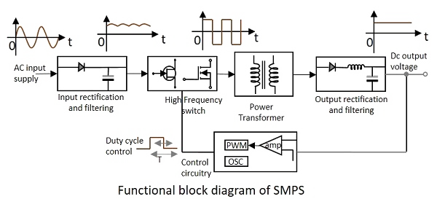

Slide 4
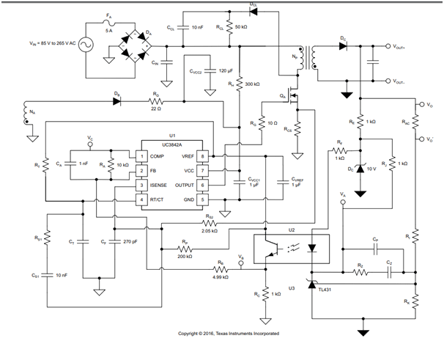

Slide 5
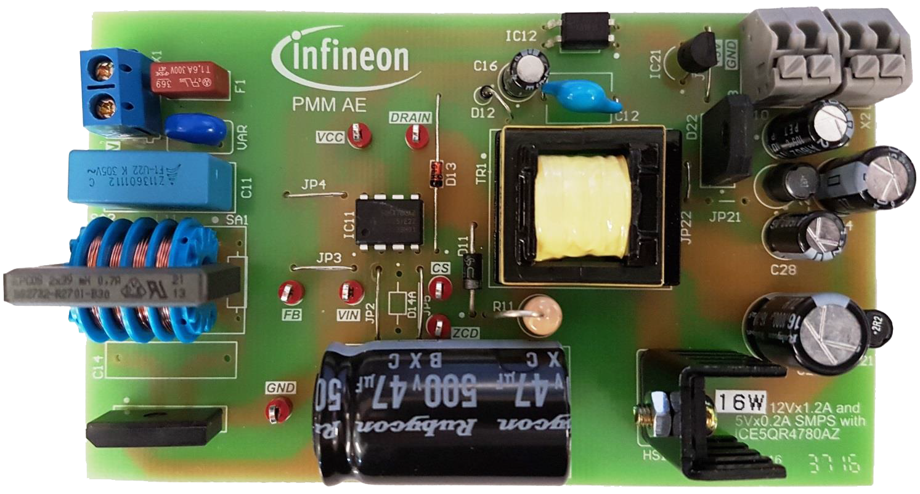

Slide 6
Thanks for
Listening…

